Slide 1
IT @ SINGAPORE
A THROUGH RESEARCH ON IT DEVELOPMENT IN SINGAPORE THROUGH COVID PERIOD.
MUZHI ZHANG - UNIVERSITY OF SAN FRANCISCO
Notes:
Goal of the project - 1min

Slide 2

Link:
https://mzhang78usfca.github.io/IT-SG/

Slide 3
Project Objectives:
Find out how good Singapore’s Covid control was, compared with other countries. And why it is attractive for some companies.
Find out how IT labor market (or overall labor market) behaves during Covid influence.
Find out if IT companies recently moved to Singapore.
Notes:
Project Objectives - ~2min

Slide 4
How I incorporated the feedback
Finish professor’s suggested improvement during code review
Finish improvement from classmates that were marked as “actionable”
See if anything else can be done
Notes:
How have you incorporated the feedback since the beta release? ~3min

Slide 5
Things done after Beta Release (success)
Tons of minor changes
Front page name
All axis tag increase font size
Labor number format
Labor legend moving
Company y axis moving
Company legend moving
Added next/prev button
Altered stacked bar chart to grouped bar chart
Notes:
~3min

Slide 6
Things done after Beta Release (in progress)
Dynamic Tooltip: Still have bug with filter interactive code. Investigating.
Notes:
~3min

Slide 7
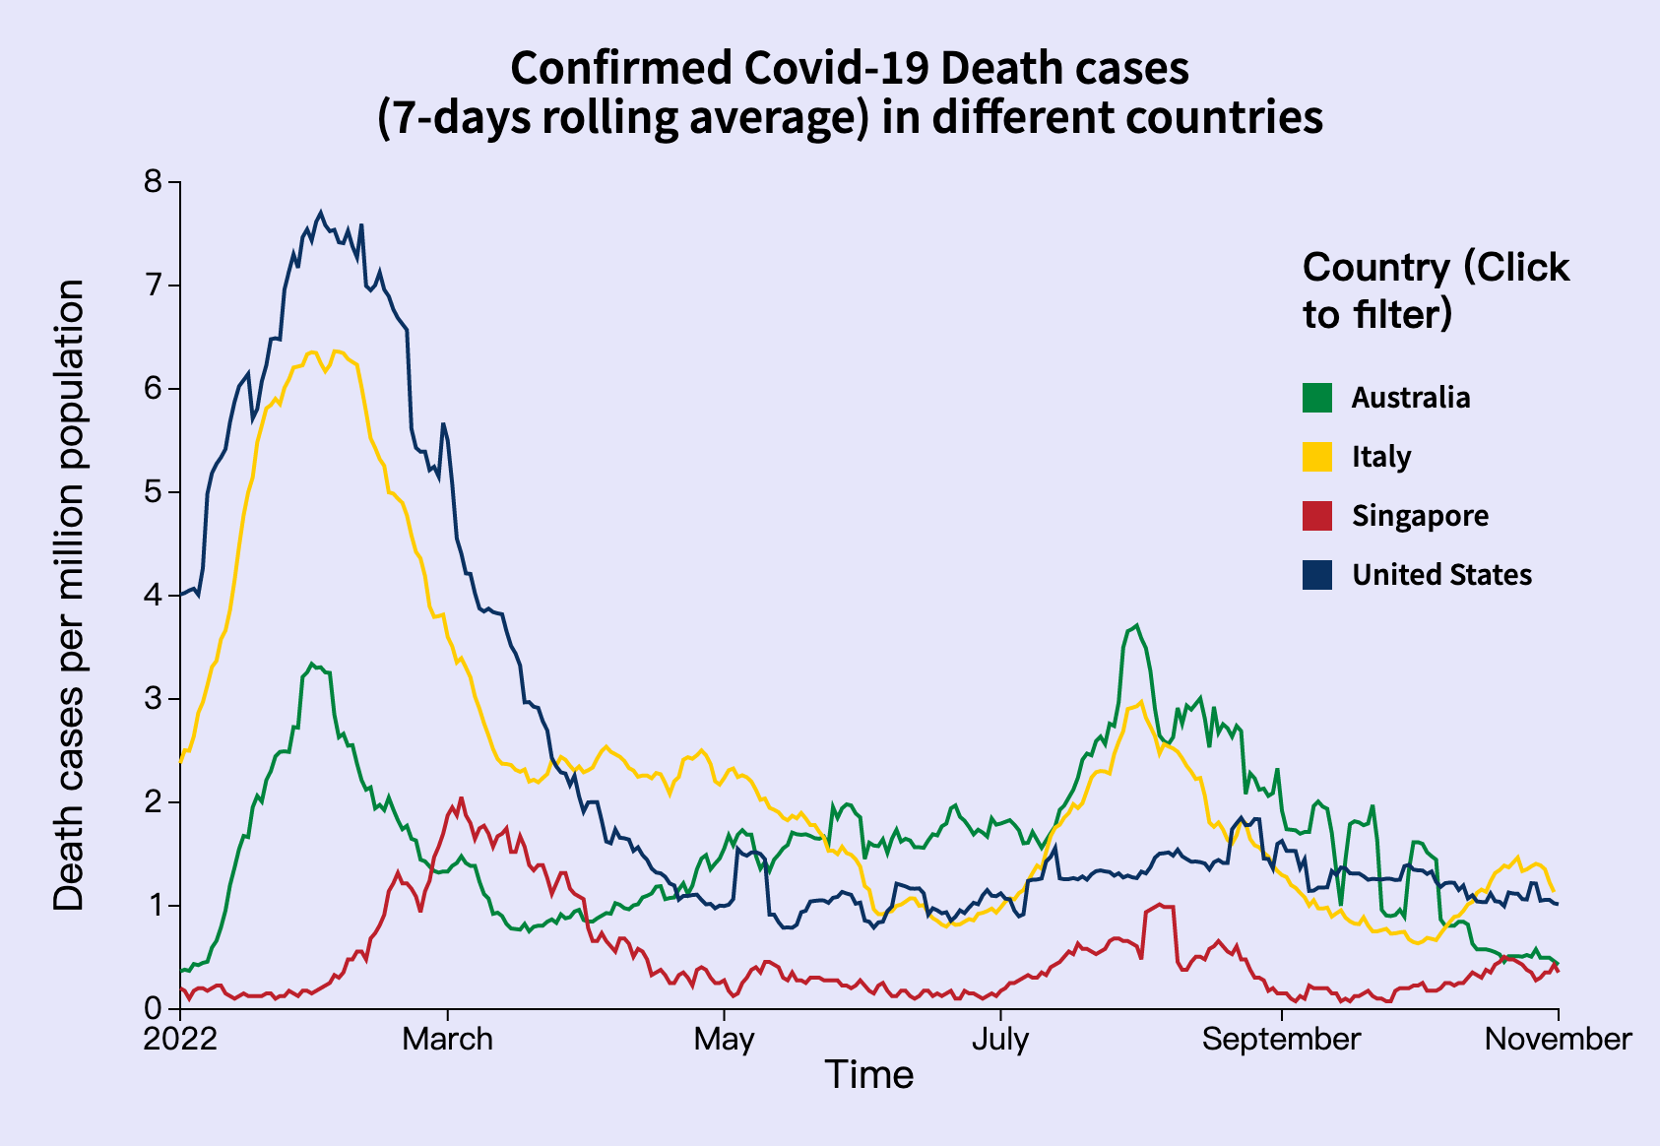
How good Singapore’s Covid control was?
Maximum and minimum of death cases/population ratio lower than other countries.
Matched expectation: Yes
Notes:
~7min

Slide 8
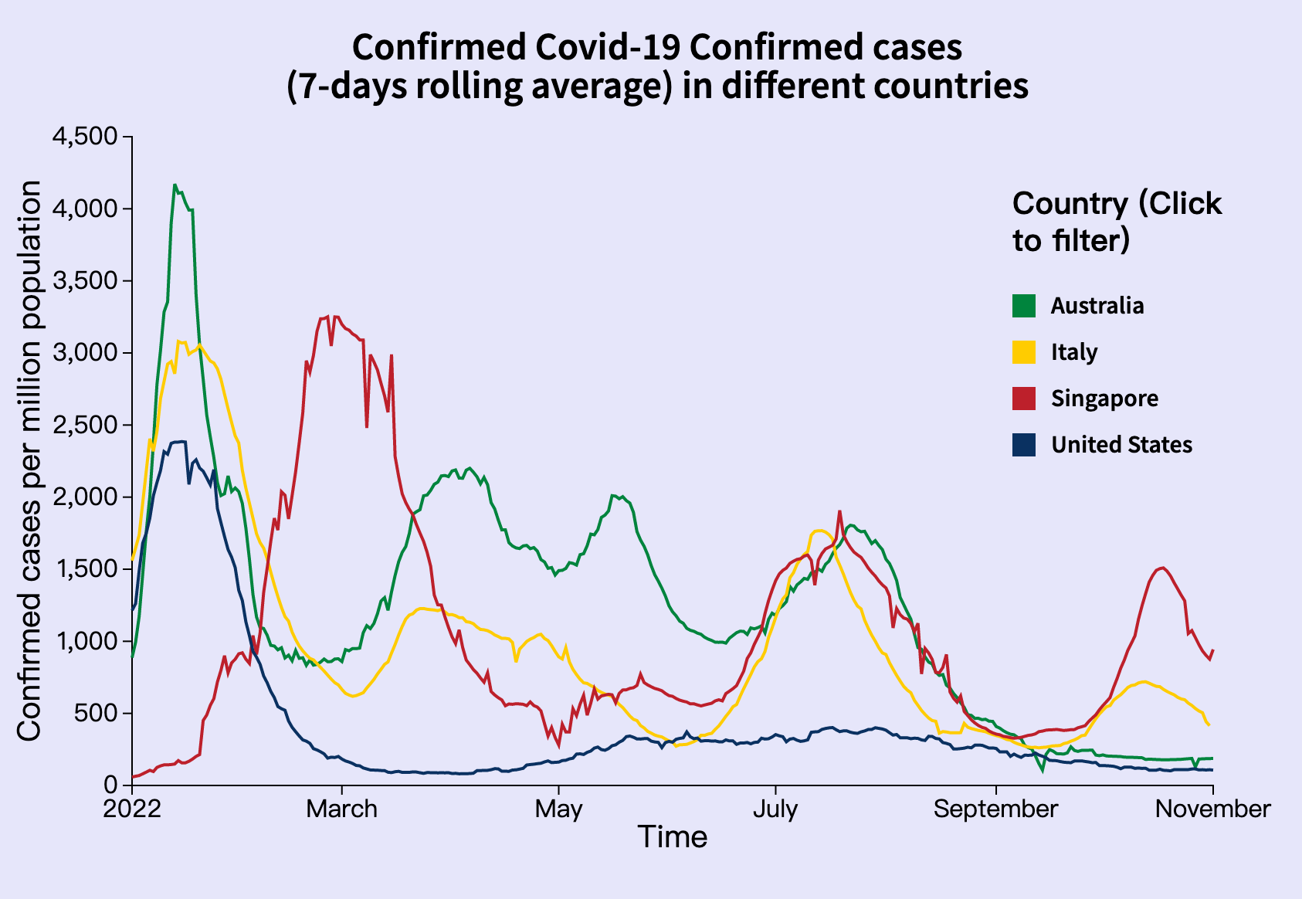
How good Singapore’s Covid control was?
Peak of confirmed cases are not lower though
Matched expectation: No
However, there was when Singapore reopened borders and dropped outdoor mask mandate. Still came with low death rate
Notes:
Singapore to ease Covid measures, reopen borders and drop outdoor mask mandate

Slide 9
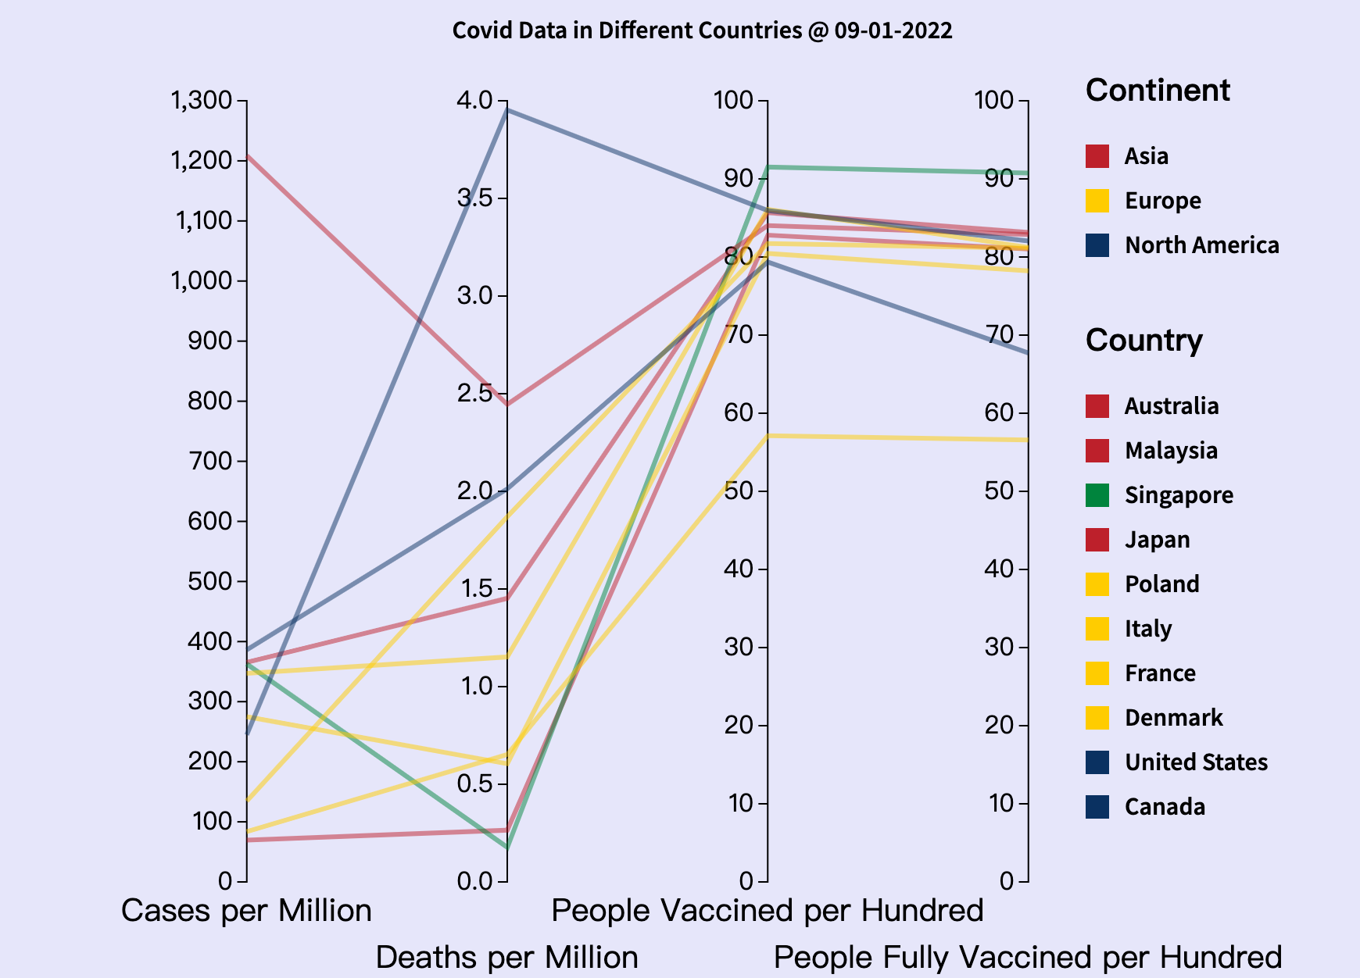
How good Singapore’s Covid control was?
Very high vaccine rate
Lot more higher than other developed countries
Matched expectation: Yes
Notes:
~7min

Slide 10
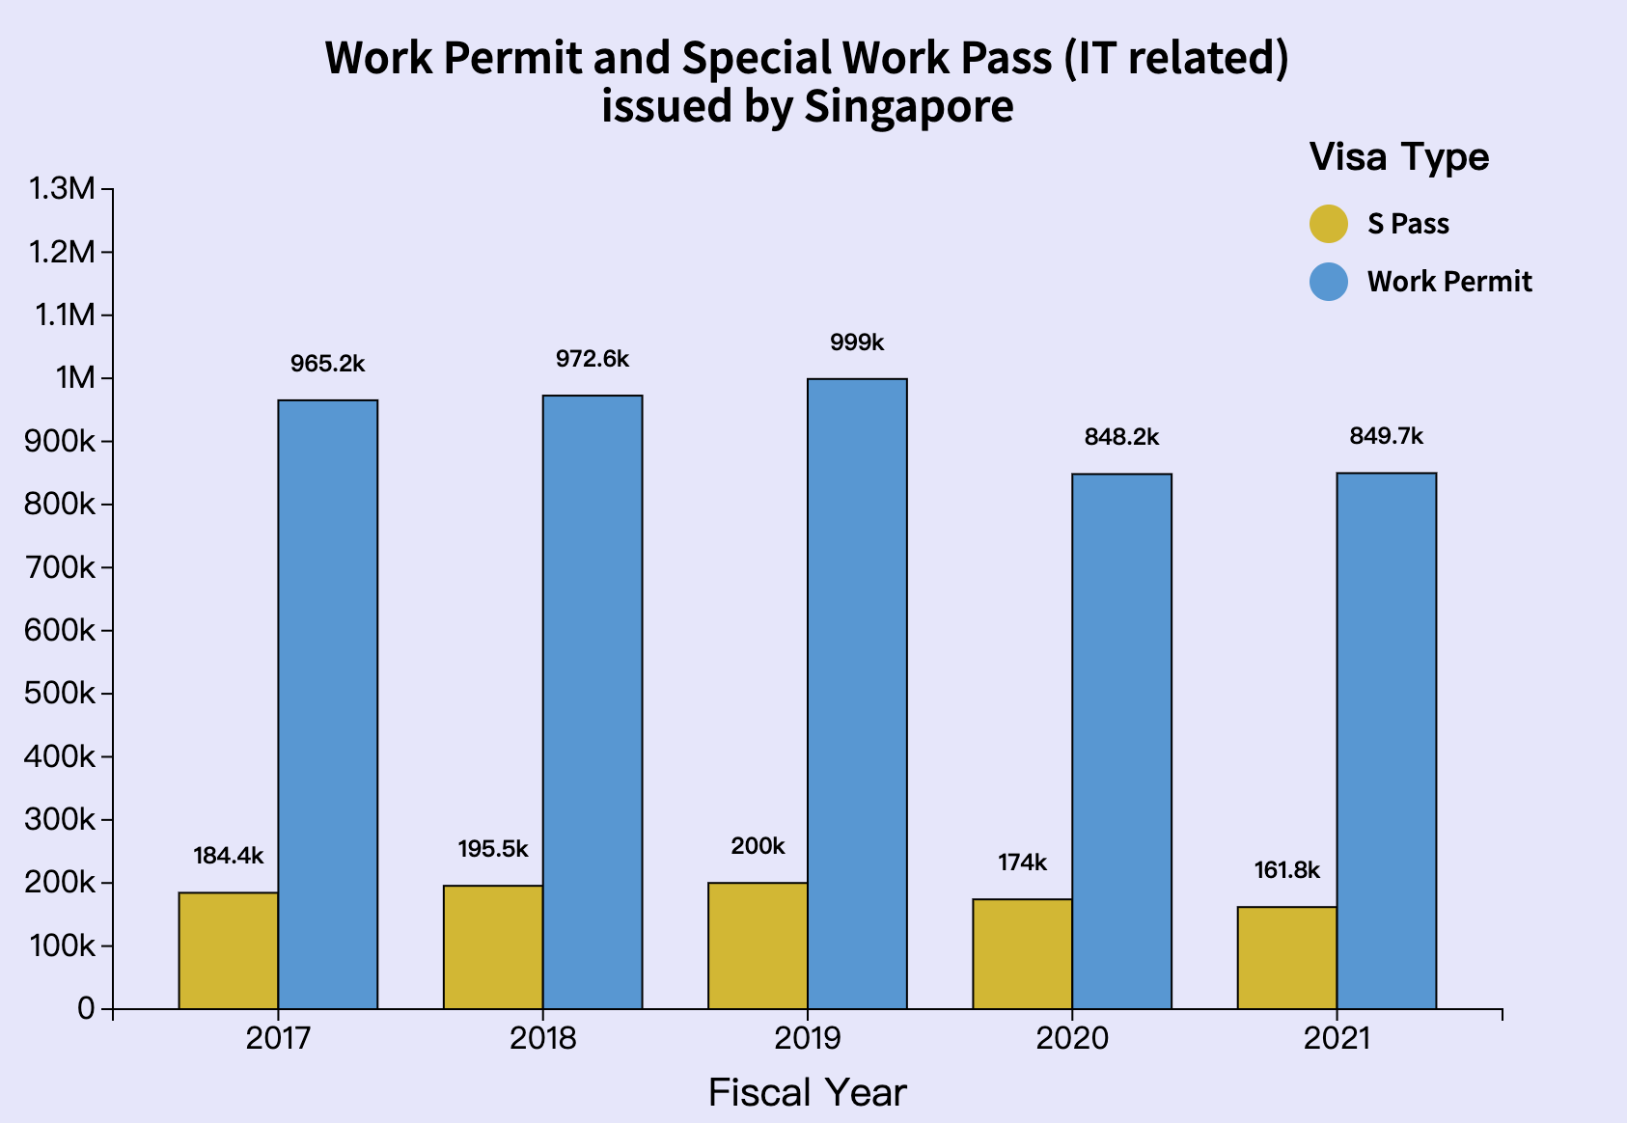
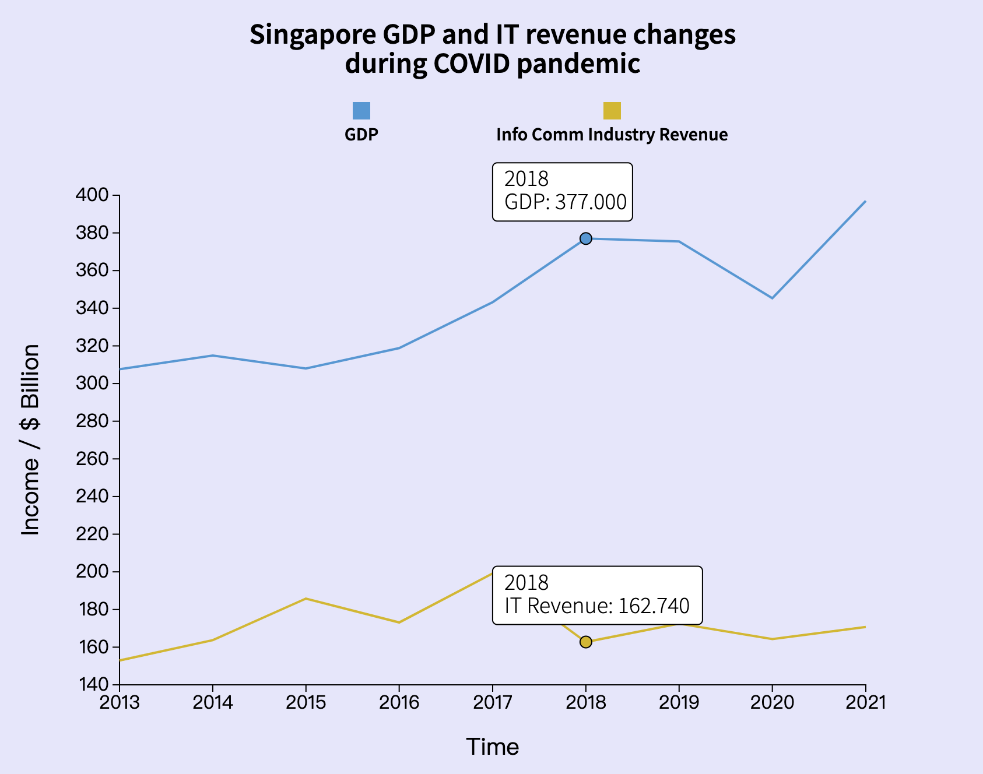
How IT labor market behaves during Covid
MATCH
Notes:
~7min

Slide 11
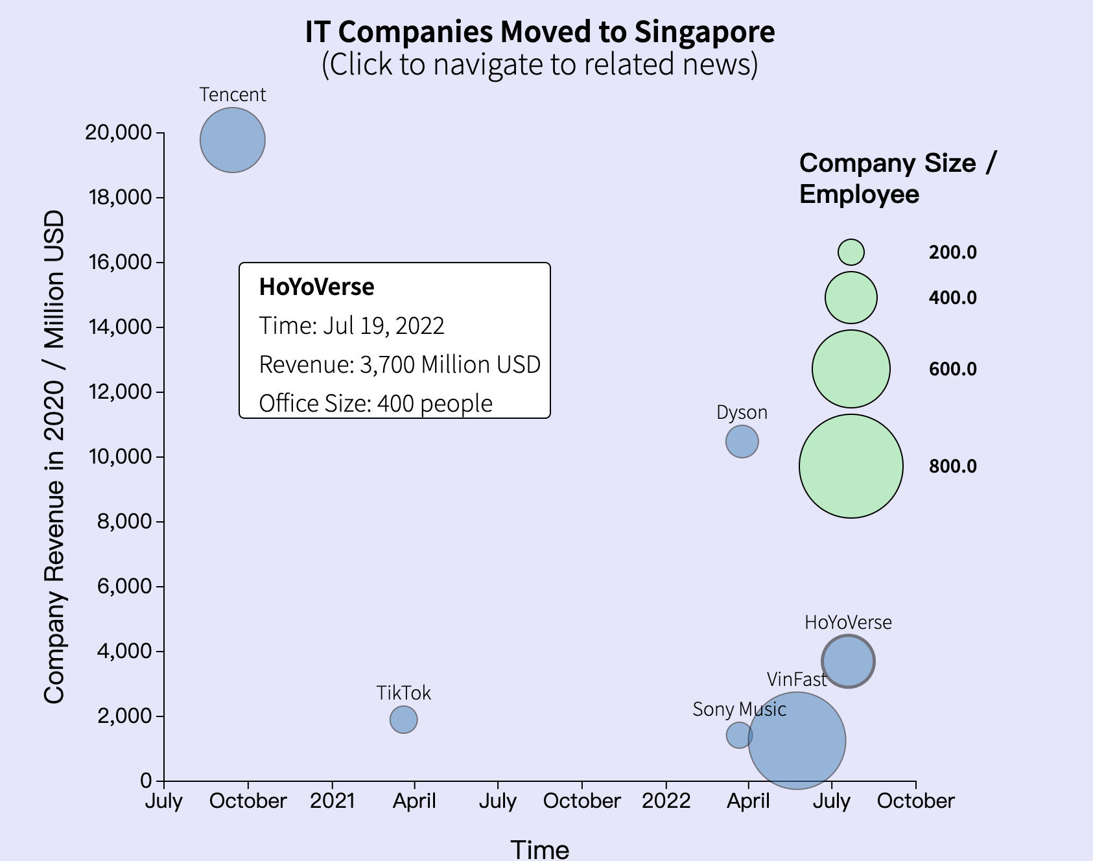
If IT companies recently moved to Singapore.
Not large in amount
Not headquarter, just office
Matched expectation: No
Matched previous slide: Yes
Notes:
~7min

Slide 12
Discussion
Application of grouped bar chart -> promising.
Separate legends with different type under different title -> promising
Things that would do different: stay away from industry report research
Notes:
~9min Overall, is the approach you took promising? What different approach or variant of this approach is better?

Slide 13
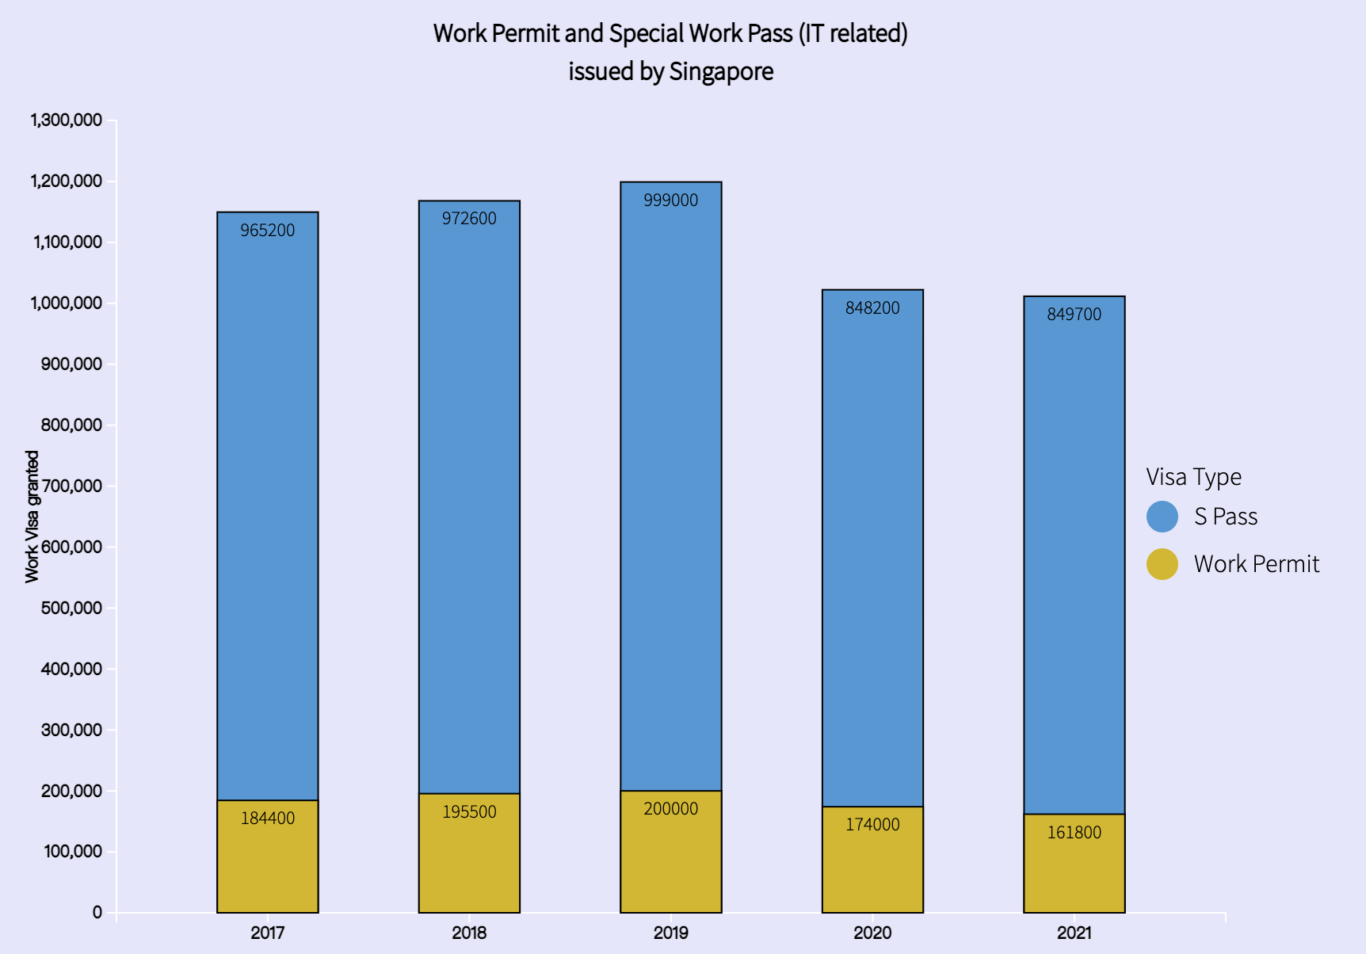
Comparing approach

Slide 14
Future work
Ask real Singaporeans: how they feel?
More company info
More interactive method

